Slide 1
Machine Learning in Fighting Games
By: Jay Bishop, Jordan Cooper, Brant Dolling, and Kegan McIlwaine

Slide 2
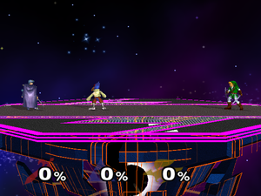
Super Smash Brothers Melee (SSBM)
Fighting game for the Nintendo GameCube
Damage to players is measured in a percentage that increases as damage is sustained
The higher a player’s percentage, the further an attack against them will propel them
Players try to eliminate each other by knocking opponents off the stage

Slide 3
Problem
Players of this game need to train to improve their skills
It is difficult to find a good training partner
Playing against the built in bots does not adequately prepare an individual for play against other humans
The built in AI does not use any highly technical moves
The built in AI acts in a very predictable manner
The built in AI does not improve

Slide 4
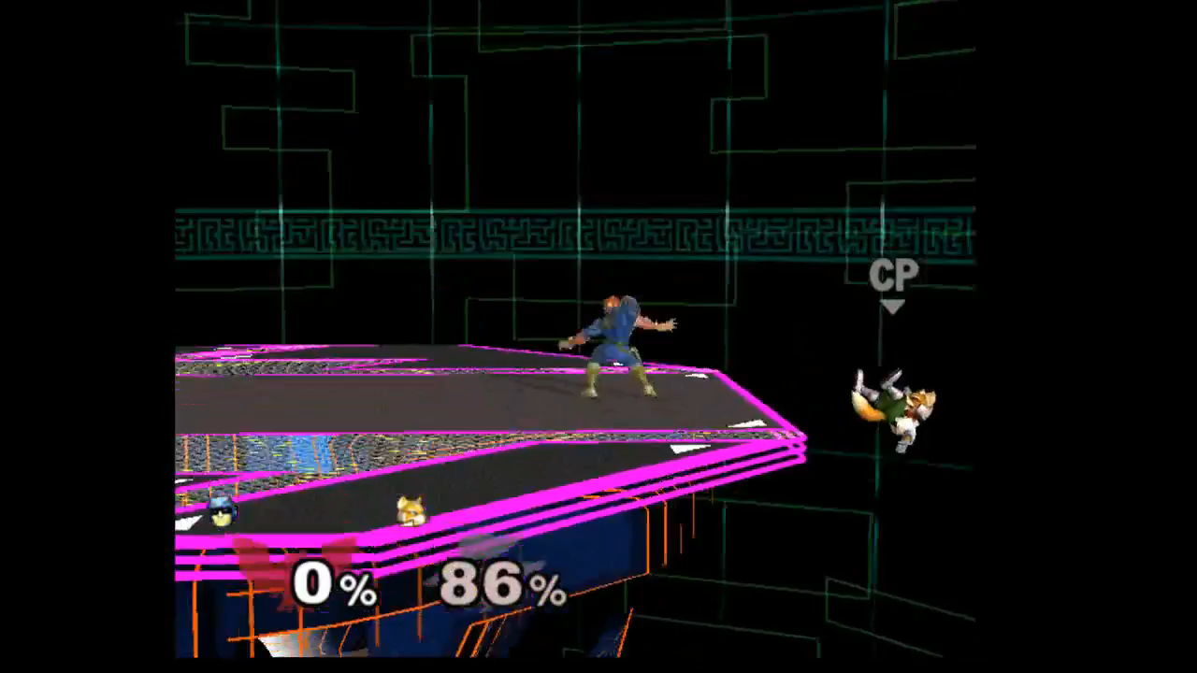

Slide 5

Our Solution
Give the players a better AI to train against
Implement a reinforcement learning algorithm that will learn to play better against the players

Slide 6
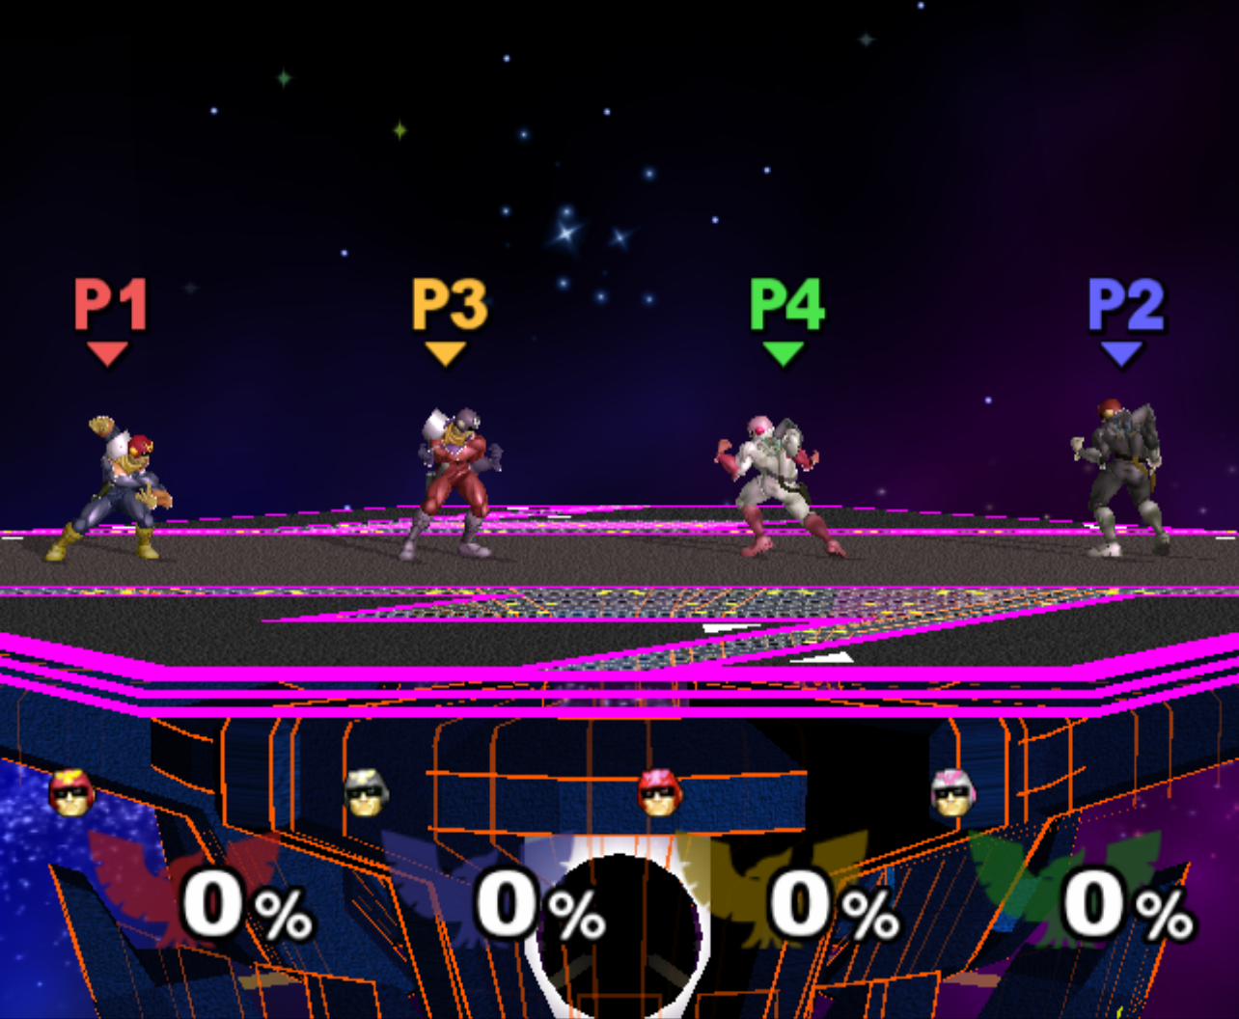
Asynchronous Advantage Actor-Critic (A3C)
A3C is a reinforcement learning algorithm that uses experiences from multiple agents to create a model
In A3C there is one global neural network and a local neural network for each player
Global Neural Network
P1 Local Neural Network
P2 Local Neural Network
P3 Local Neural Network
P4 Local Neural Network

Slide 7
A3C (Step 1)
Before training, the global network is copied to all local networks
Global Neural Network
P1 Local Neural Network
P2 Local Neural Network
P3 Local Neural Network
P4 Local Neural Network

Slide 8
A3C (Step 2)
After gathering experiences a local network applies updates to the global network
Global Neural Network
P1 Local Neural Network
P2 Local Neural Network
P3 Local Neural Network
P4 Local Neural Network

Slide 9
A3C (Step 3)
The global network is then copied back to the local network
These steps are repeated asynchronously for each network to train the bot
Global Neural Network
P1 Local Neural Network
P2 Local Neural Network
P3 Local Neural Network
P4 Local Neural Network

Slide 10
Network Architecture
State Information
Layer 1
Layer 2
Action Probabilities
Size: 78 nodes
Size: 128 nodes
Size: 128 nodes
Size: 40 nodes

Slide 11

Interaction with the Game
The memory watcher included in the emulator is used to get game state changes
Unix named pipes are used to send controller commands to the emulator
Controller Actions
Game State Changes

Slide 12
Reward System
Used to let the bot know how it is doing
Bot awarded a point for each time an opponent dies; Loses a point for dying
Bot is awarded 0.01 points for each percent of damage inflicted on opponents and loses 0.01 for each percent of damage it takes
Bot also loses points at a reduced rate (20%) for their allies dying or sustaining damage

Slide 13
Training
Area where we encountered the most problems
Difficult to debug
Have to reset training for every change in architecture
Began training our bot against a single in-game level 5 opponent
Ended up using A3C’s shared network to speed up training by having the bot play against itself

Slide 14
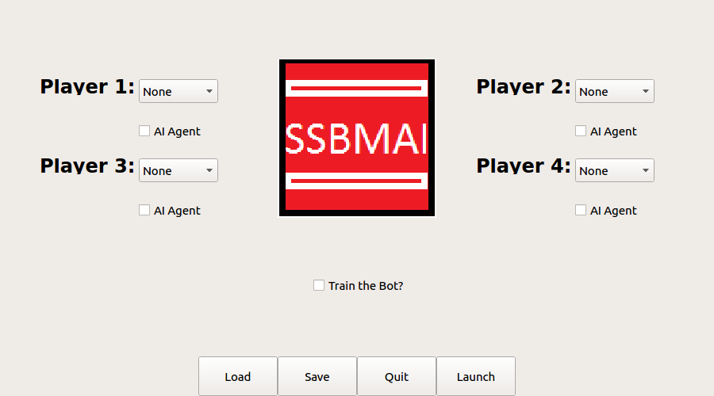
PyQT – GUI
Launch the bot
Multiplayer selection
Train a bot

Slide 15
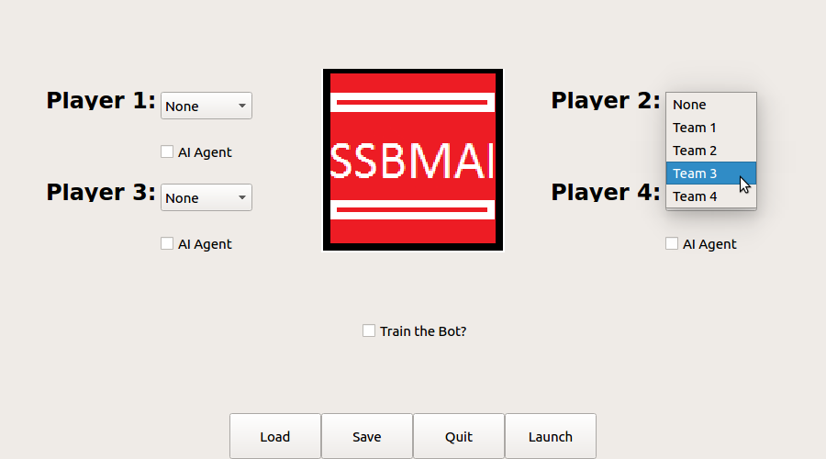

Slide 16


Slide 17
Problems With the AI
Problems
Slow to train
No way to share progress with others

Slide 18
Website
Helps fix issues with training bots
Pushes training off onto others by allowing them to upload trained bots
Allows for more specialized bots in terms of character and stage to be created by the community

Slide 19
Website Technologies
Used HTML/CSS/JavaScript for the frontend
PHP/MySQL for the backend and database design
JavaScript AJAX to communicate between frontend and backend

Slide 20
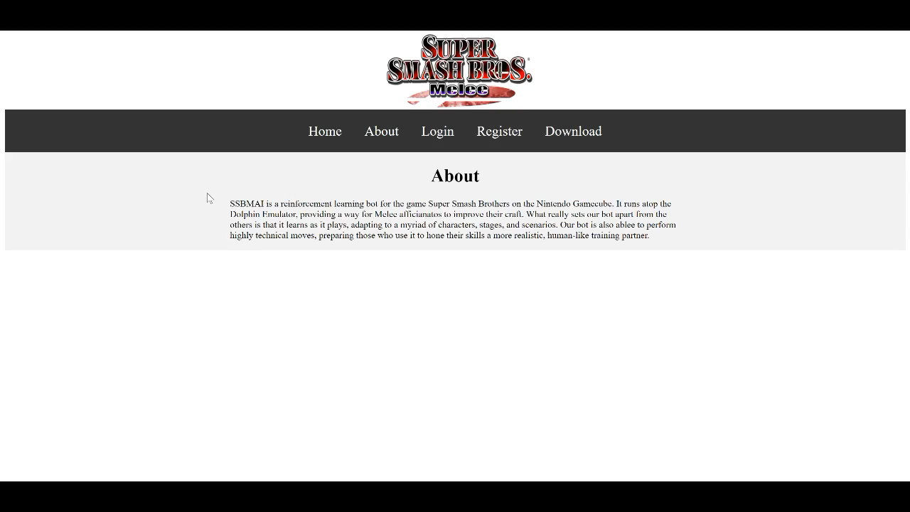

Slide 21
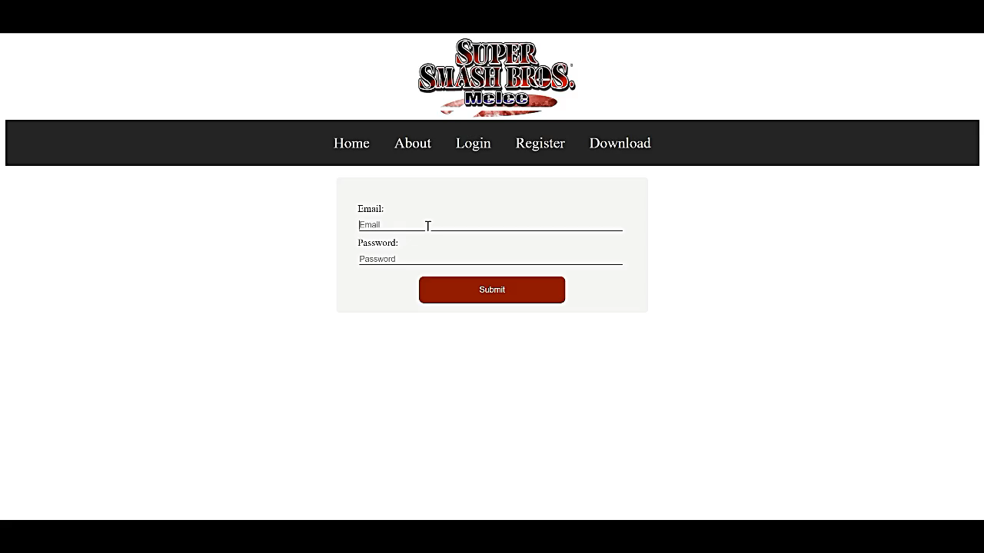

Slide 22
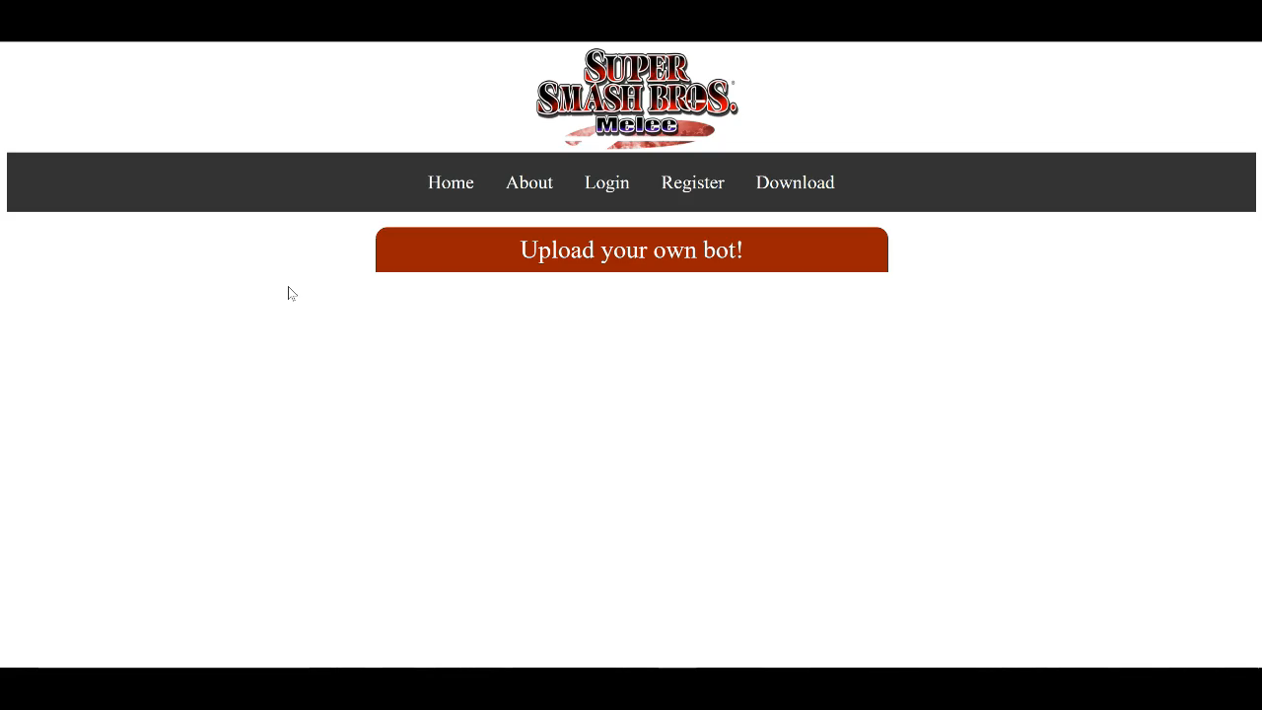

Slide 23
Conclusion
SSBMAI allows those who play melee to play against a smart bot that learns as it goes in order to improve
Our GUI provides an easy to use interface that helps set up the bot
Our website allows users to train their own unique bots and upload them for others to use

